Slide 1



Pevekar Zainab Ashfaque
Data Science Jobs Analytics
Pevekar Zainab Ashfaque

Slide 2

IMPORTANCE OF ANALYZING DATA SCIENCE JOB TRENDS
Analyzing data science job trends is of paramount importance in today's dynamic and rapidly evolving professional landscape
The analysis of data science job trends is not merely a theoretical exercise but a practical necessity for staying competitive, fostering professional growth, and contributing to the overall dynamism and efficiency of the data science ecosystem.

Slide 3
DATASET OVERVIEW:
Data Source: Kaggle
Number of Records: 9356
Variables: The dataset encompasses various variables related to jobs, including but not limited to work year, job title, job category, employment type, experience level, location, and salary information.

Slide 4
AIM: TO FIND SCOPE OF DATA SCIENCE JOBS AND THEIR SALARIES
By analyzing this dataset, the goal is to uncover patterns, correlations, and valuable information that can aid job seekers, employers, and researchers in understanding the dynamics of the data science job market.
This includes identifying the most sought-after geographical distribution of job opportunities, salary trends, and any other pertinent factors influencing the field.
Ultimately, the aim is to leverage this dataset to enhance decision-making processes for both job seekers and employers in the data science domain.

Slide 5
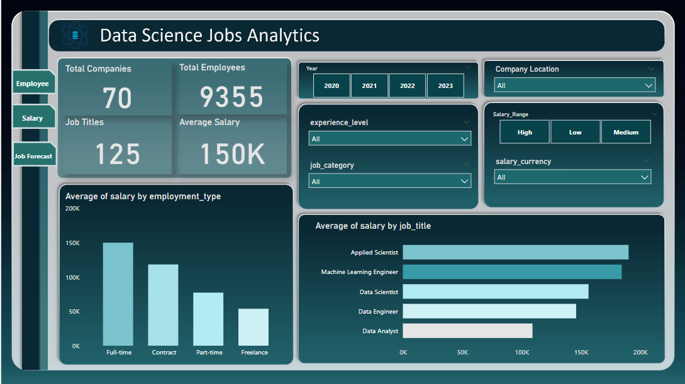
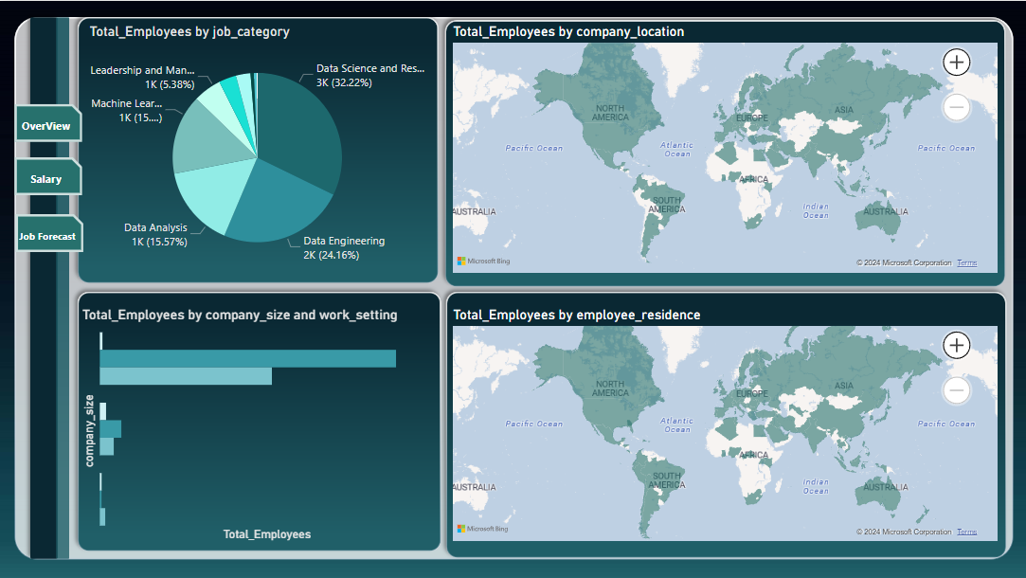
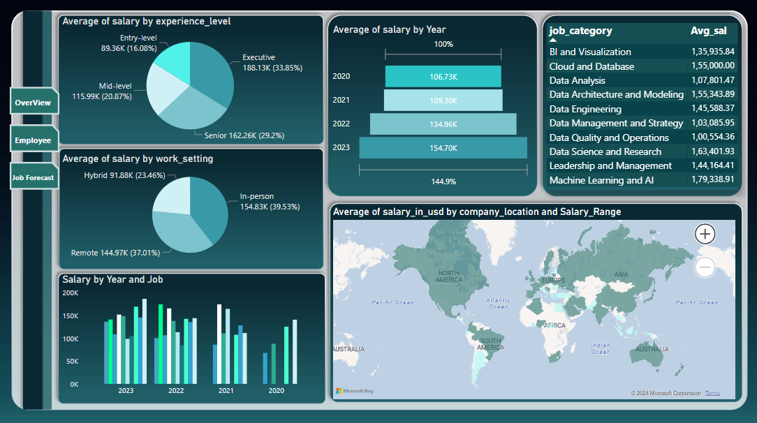
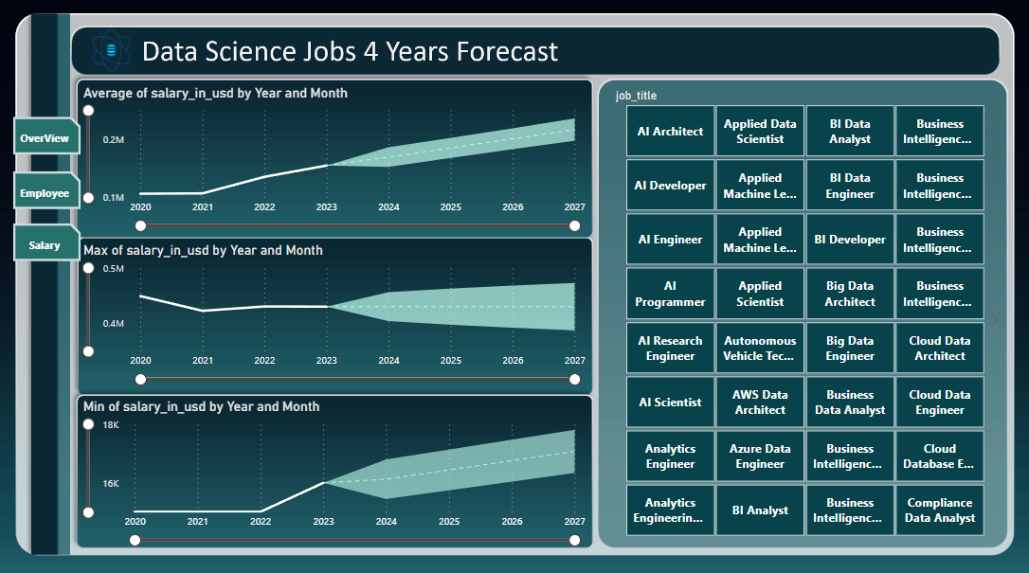

Slide 6
INSIGHTS OF DATA SCIENCE JOBS
Salary Analysis: Average salary of Applied Scientist is more followed by Machine Learning Engineer , Data Scientist, Data Engineer and Data Analyst.
Salary Trends Over Years and Experience: The salary over years have increased depending on the Experience i.e. The Seniors earn more than the Mid-Levels and Entry Level
Employment Insights: Data Science and Research category has highest percent of employees going up to 32%, Followed by Data Engineering which is 24% and Data Analysis which is 15%.
Average salary of Full time employees is more than the employees who work on Contract , Part-time or Freelancing.
Company Size and Work Setting Preferences: Number of Employees in Medium size (M) companies Working-In-Person is more than the employees who are working Remotely and Hybrid. Followed by the Large size (L) and Small size Companies.
Company Location Impact: The USA has highest number of employees Followed by The UK and Canada.
The Salary Range in the USA , UK, Canada, India is High Whereas the Salary Range in Pakistan, Egypt is Low
Forecast: The Average Salary over the span on 4 years will Increase

Slide 7
THANK YOU

